Slide 1
GROUP – 7 WORD FREQUENCY COUNTER
Ramya Bejawada
Varsha Narayana
Suvithra Murugan
Durga Bhavani Asadi

Slide 2
DAY 1 TO 5:
Day1: SRS Briefing.
Day2: Designing.
Day3: Coding.
Day4: CPPUnit , UT and IT.
Day5: GitHub and Presentation

Slide 3
DAY1:INTRODUCTION:
Word frequency counter is an application which counts number of times a word appears in multiple files.
Frequency of words are stored in Map.
Common words and invalid words are excluded from the frequency count.
If user doesn't give any input file error will be displayed.
Common words are stored in commonwords.txt
Invalid words are stored in invalid.txt

Slide 4
Non Functional Requirements:
MultiFile MultiDirectory Solution:
1) SRC
2)OBJ
3)INCLUDE
4)COMPILE
5)BIN
6)TOOLS

Slide 5
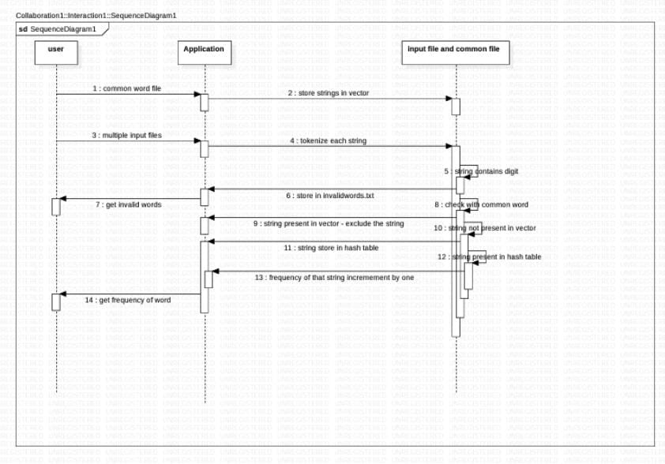
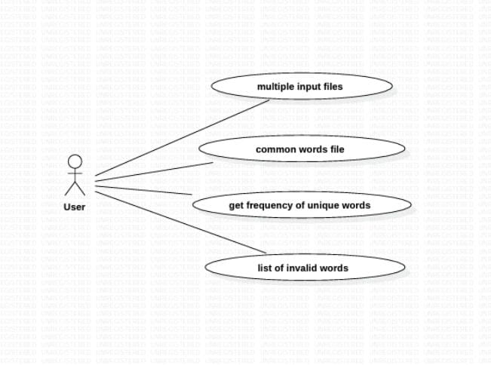
Day2:Designing:
USE-CASE DIAGRAM.
SEQUENCE DIAGRAM.

Slide 6
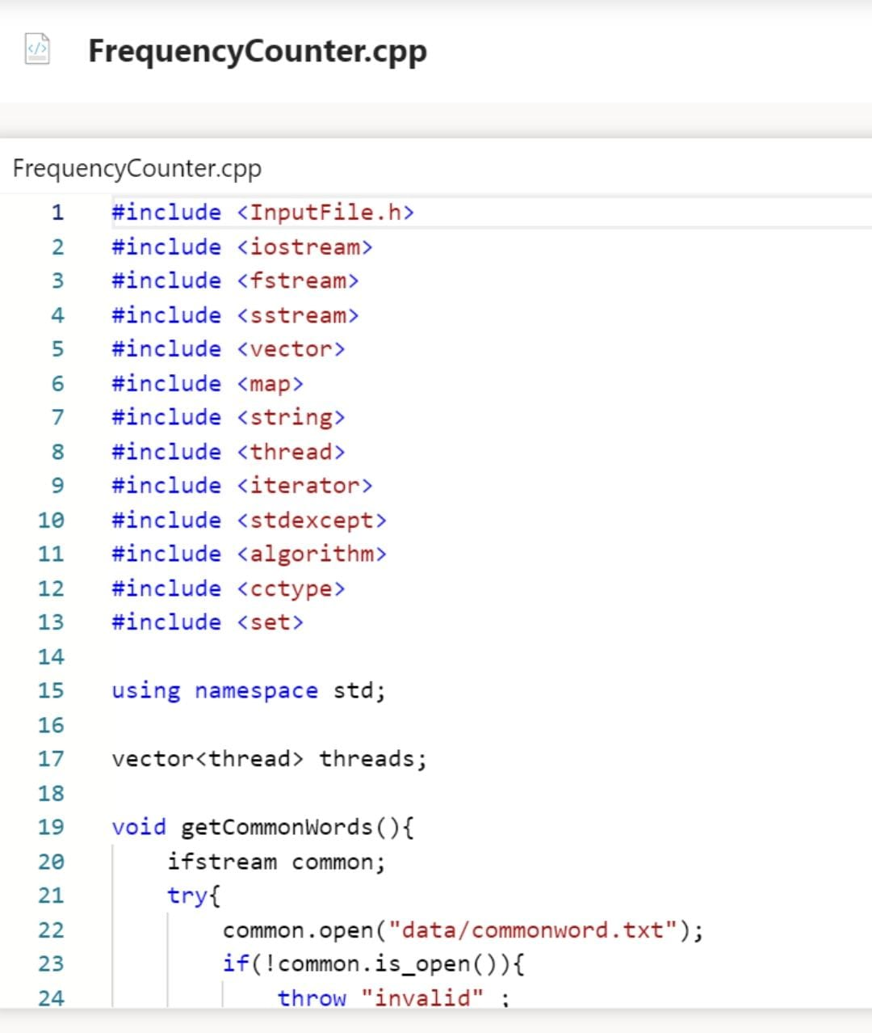
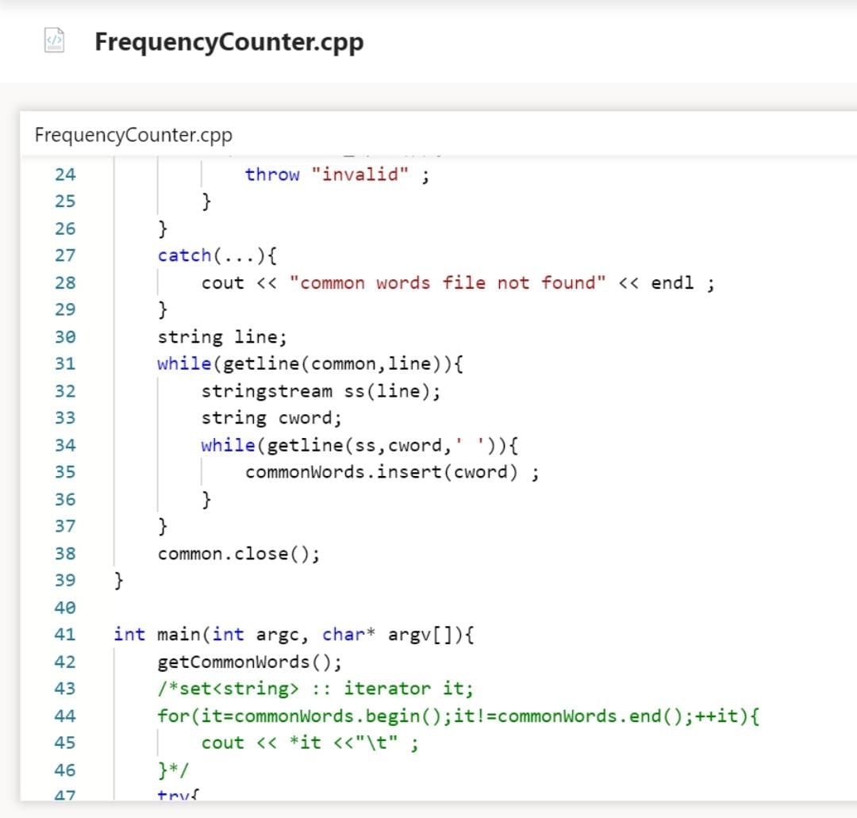

Slide 7
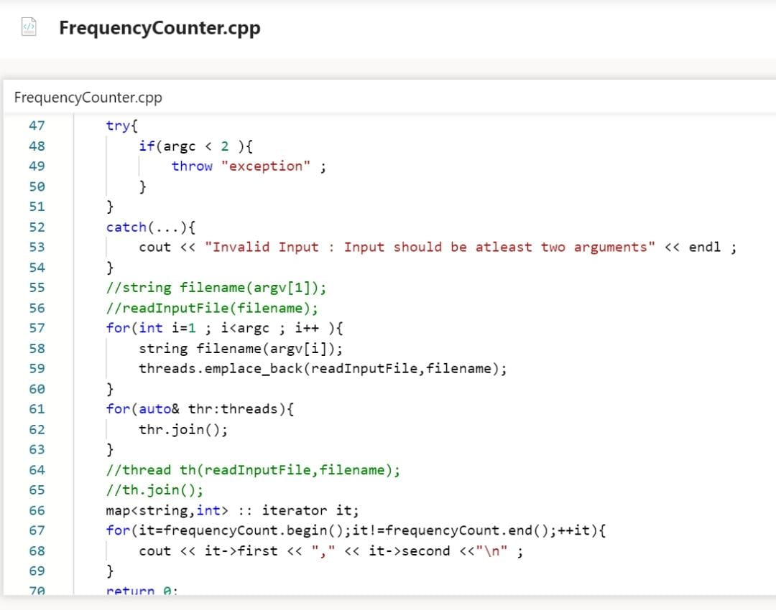
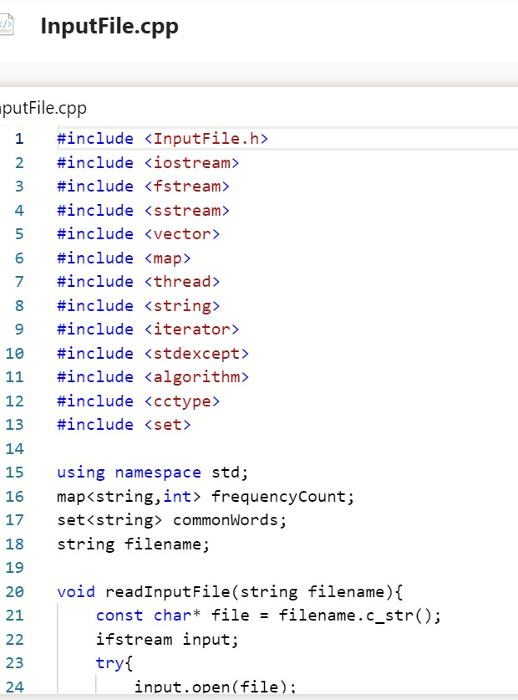

Slide 8
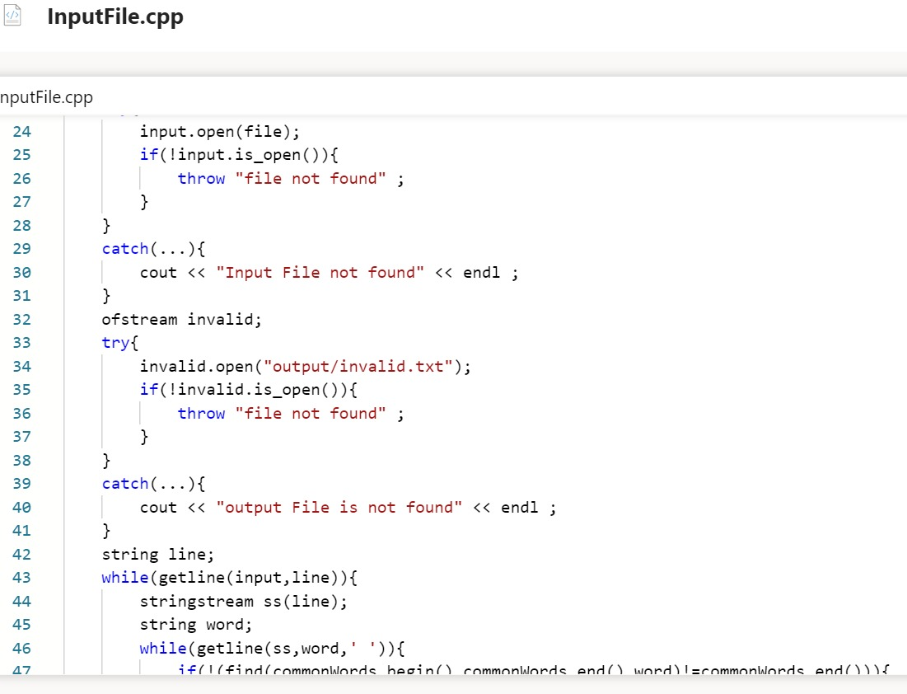
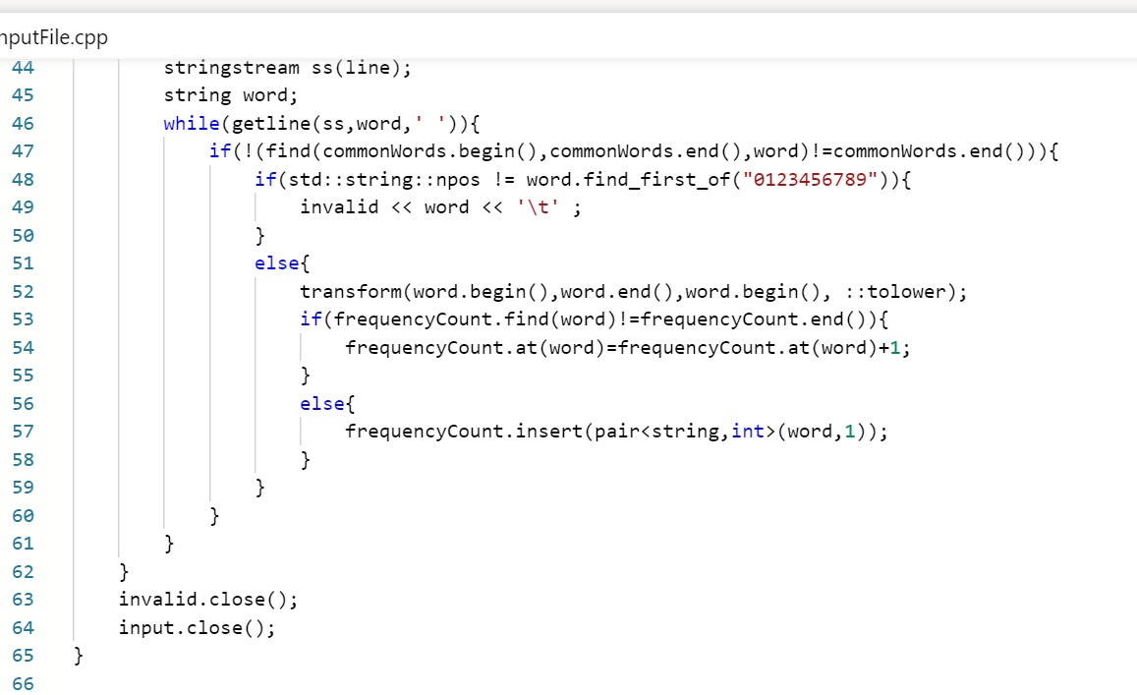

Slide 9
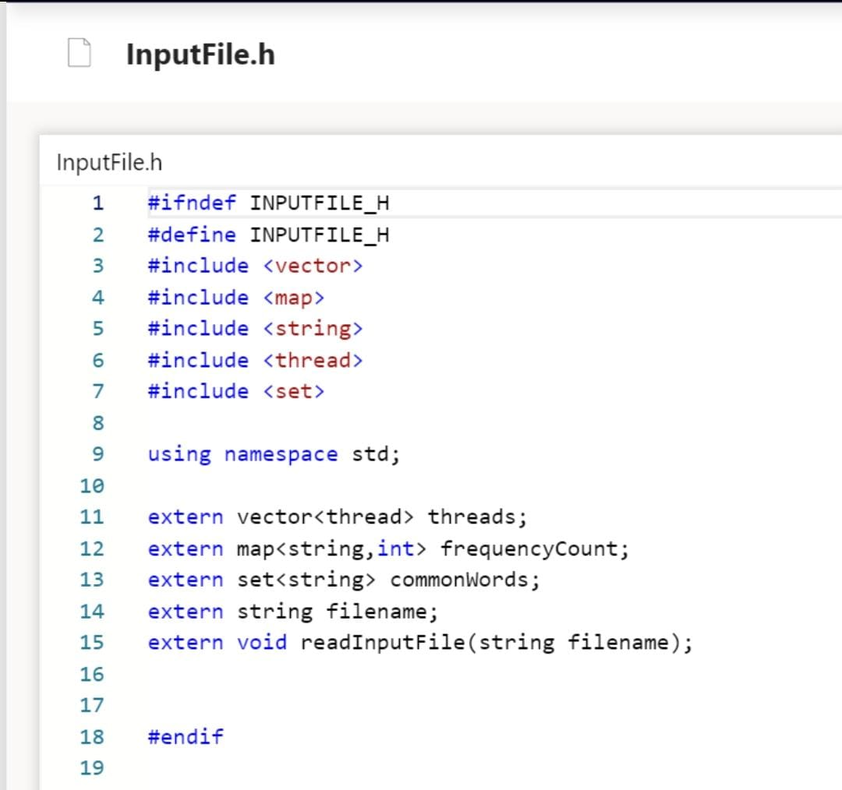

Slide 10
Day4:Testing Tools and Process:
1) Valgrind
2)CPP Unit

Slide 11
Conclusion:
Frequency of unique words are displayed.
Common and Invalid words are excluded from the frequency count.
We have implemented threads for giving multiple input files.

Slide 12
THANK YOU

